Slide 1
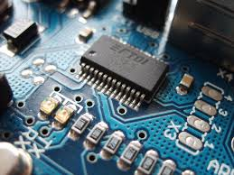
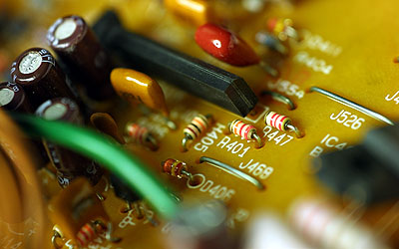

CO2015 Introduction to Transistors and Appliactions

Slide 2
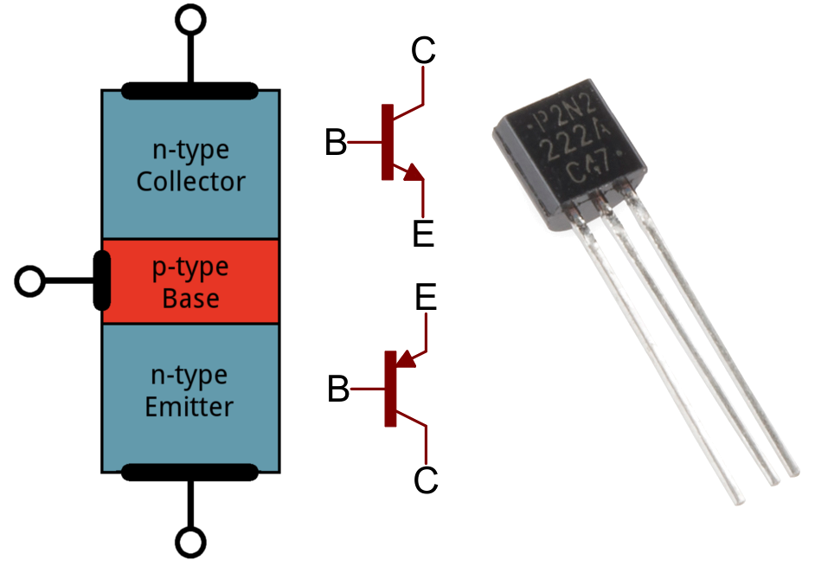
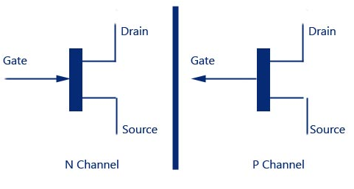
What is Transistor?
Transistor is a semiconductor device used to:
Amplifier signal
Switch signal or electrical power
There are two types of basic transistor out there: Bi-Polar Junction (BJT) and Metal-Oxide Field-Effect (MOSFET)

Slide 3
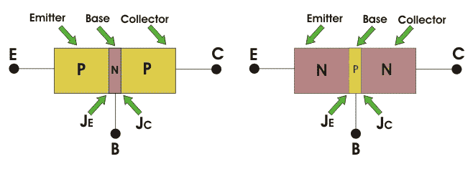
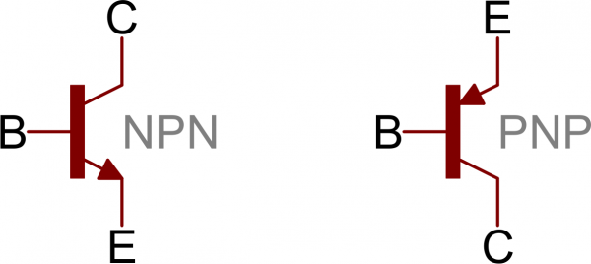
Transistor
Bi-polar Junction Transistor (BJT)
Collector (C), Base (B), and Emitter (E)

Slide 4
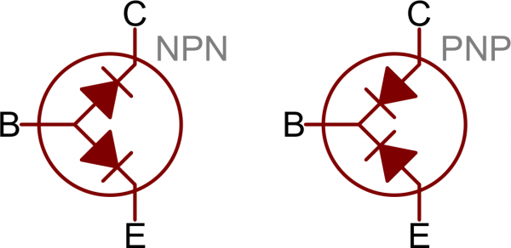
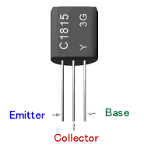
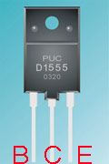
Transistor = 2 Diodes
Checking transistors is similar to diodes
Pin order: ECB or BCE

Slide 5
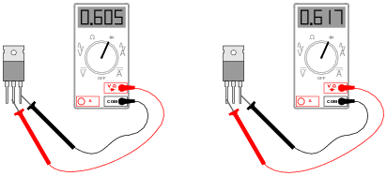
Exercise
From these measurements, determine what type of BJT this is (PNP or NPN)

Slide 6

Answer
PNP transistor

Slide 7
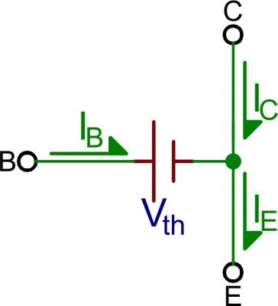
Saturation Mode
Saturation is the ON MODE of a transistor
A transistor in saturation mode acts like a short circuit between collector and emitter

Slide 8
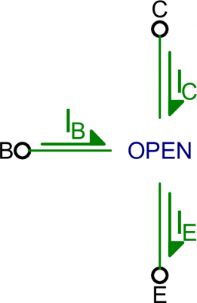
Cut-Off Mode
Cutoff mode is the opposite of saturation
There is no collector current, and therefore no emitter current
It almost looks like an open circuit

Slide 9
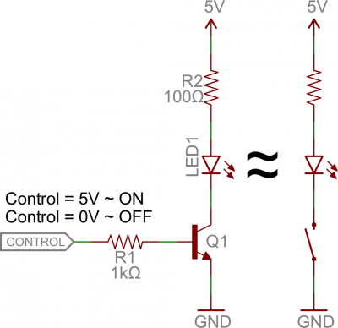
Applications I: Switches
When the voltage at the base is greater than 0.6V, the transistor starts saturating 🡪 short circuit
When the voltage at the base is less than 0.6V the transistor is in cutoff mode 🡪 open circuit
Low-side switch

Slide 10
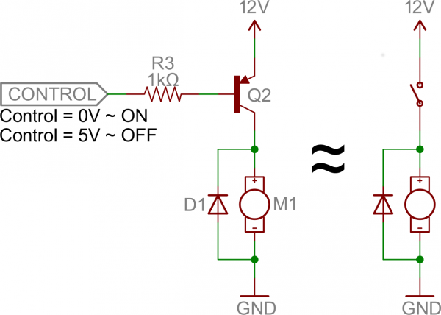
Applications I: Switches
High side switch
PNP transistor: Control signals are reversed
A transistor without a resistor on the base is like an LED with no current-limiting resistor

Slide 11
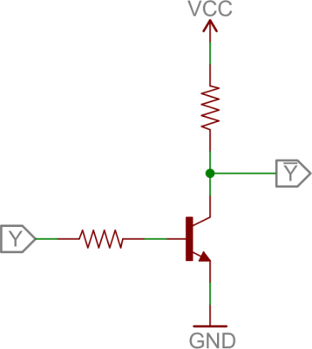
Logic Gate - NOT

Slide 12
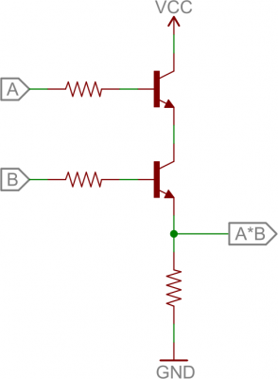
Logic Gates

Slide 13
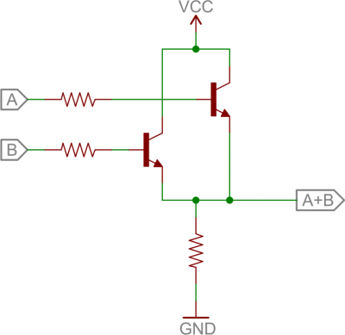
Logic Gate

Slide 14
H-Bridge

Slide 15
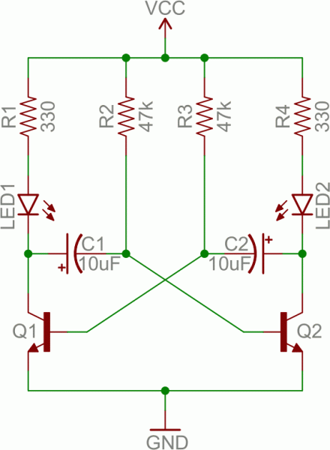
Oscillator
Q2 ON – Q1 OFF
V_{BE} (Q2) = 0.7V
The voltage from V_{CC} charges C1 to 4.3V
4.3V
0.7V

Slide 16
Oscillator
Positive of C2 is connected to GND (due to Q2 is ON)
VCC slowly charges C2 until 0.7V 🡪 Q1 ON
0.7V
0V

Slide 17
Oscillator
VC1 is currently 4.3V
Positive pin returns to 0V
Negative pin goes to minus 4.3V 🡪 Q2 OFF
0V
-4.3V

Slide 18

Oscillator

Slide 19
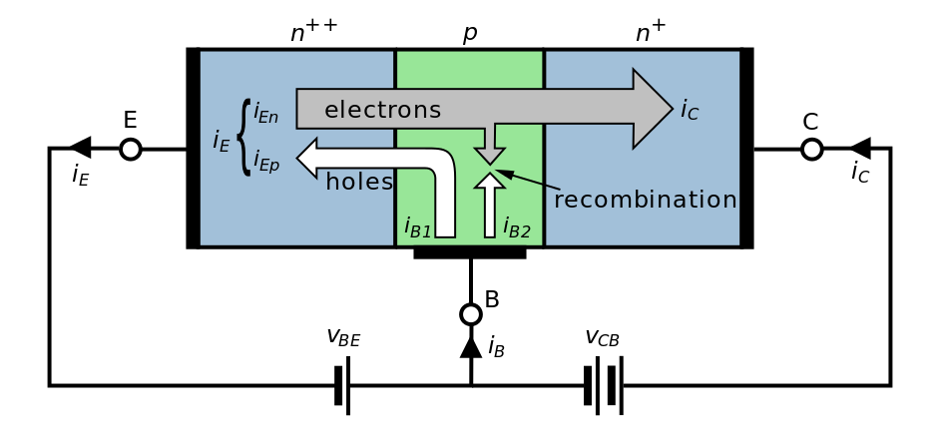
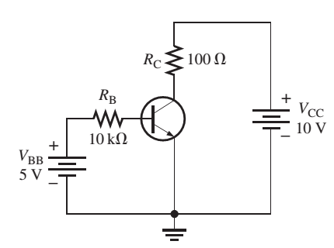
CO2015 Amplifier using Bipolar Junction Transistor

Slide 20
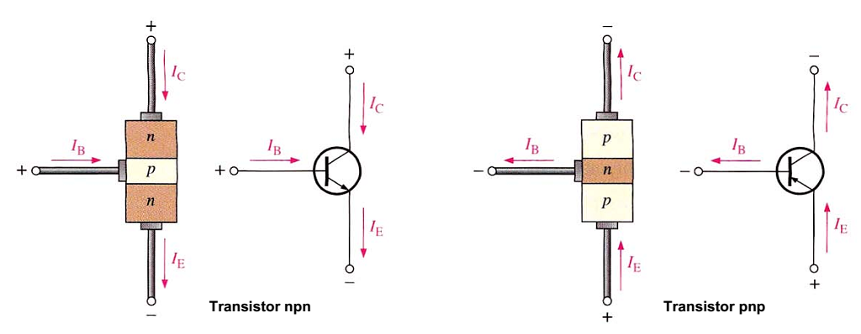
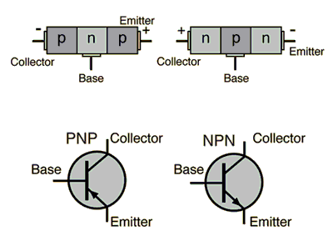
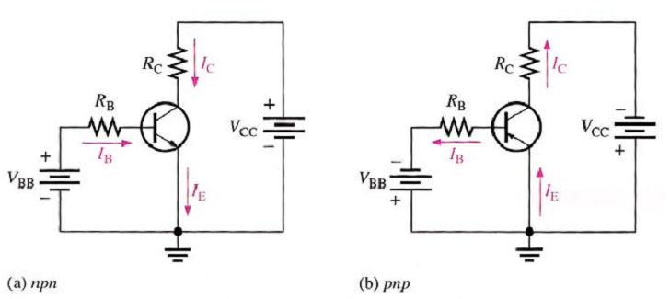
Bipolar Junction Transistor

Slide 21
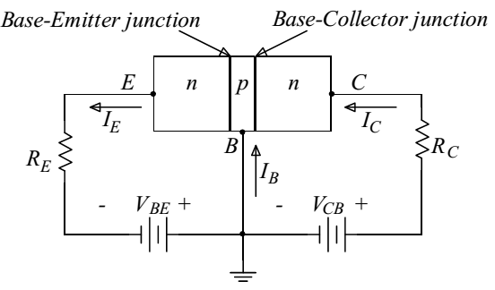
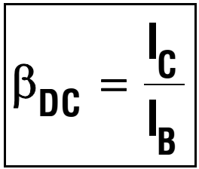
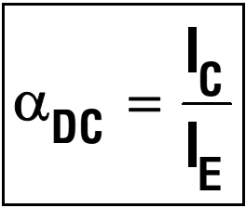
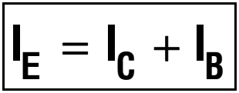
BJT as Amplifier

Slide 22
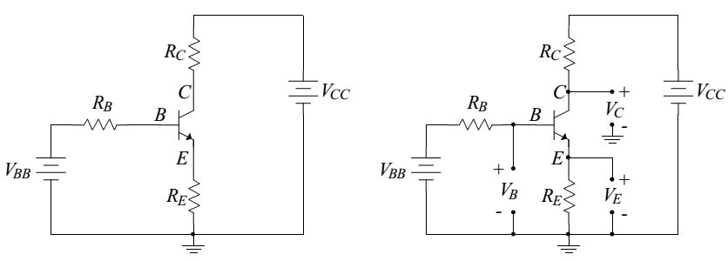
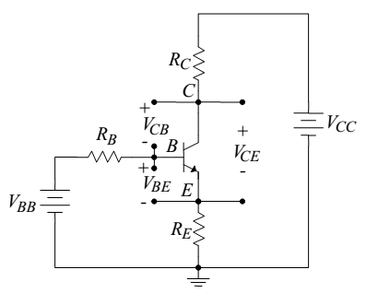
Voltages in a BJT
V_{CC} , V_{BB}
V_{C} , V_{B} , V_{E}
V_{BE} , V_{CE} , V_{CB}

Slide 23
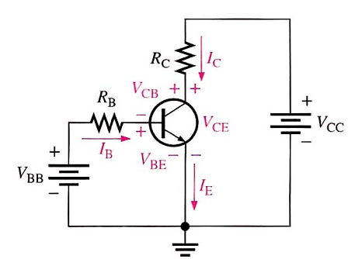
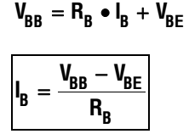
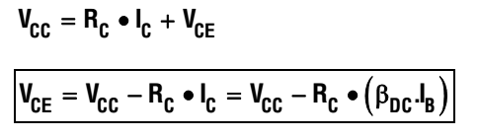
Current and Voltage Analysis
E-B: Forward Bias (like diode)
V_{BE} ≈ 0.7V
Base Circuit
Collector Circuit

Slide 24

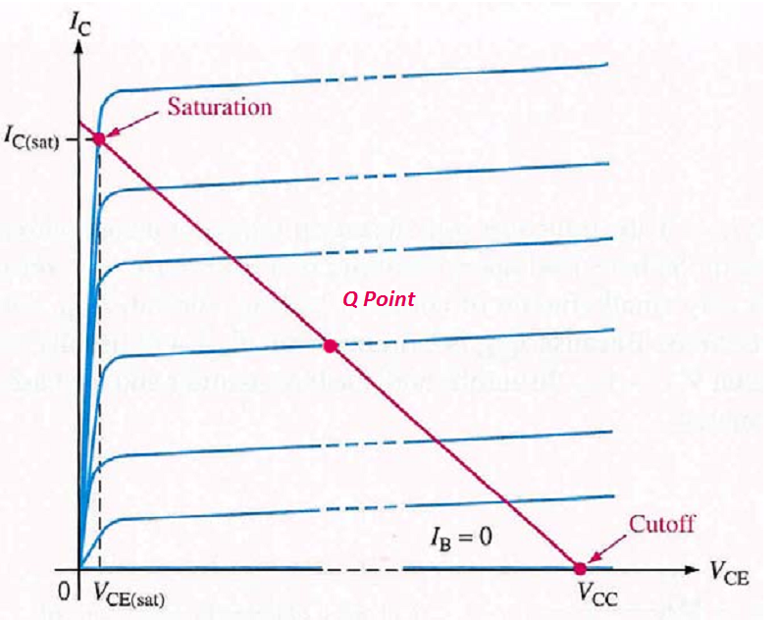
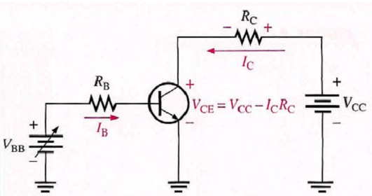
Load Line Analysis
DC & X Axis: V_{CE} = V_{CC} ⇒ I_{C} = 0 (Cut off)
DC & Y Axis: I_{C} = V_{CC}/R_{C} ⇒ V_{CE} = 0
DC & Characteristic Line: Q-point

Slide 25
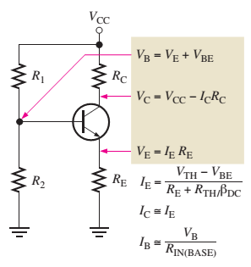
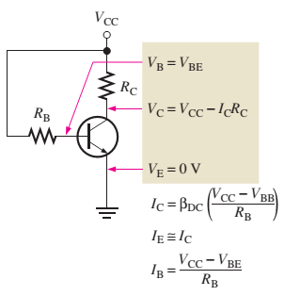
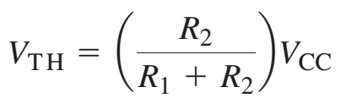
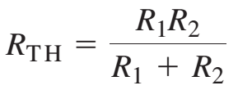
Voltage Division

Slide 26
Exercise 1
Determine I_{B} ,I_{C} ,I_{E} ,V_{BE} ,V_{CE} and V_{CB} for the given circuit when β_{DC} = 150

Slide 27
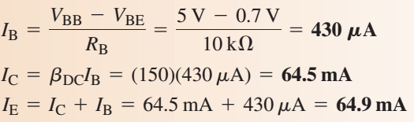
Solution 1

Slide 28
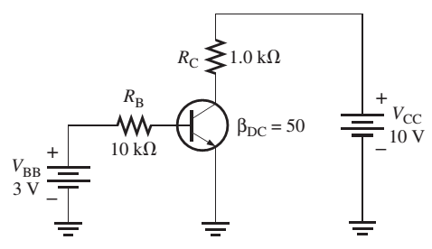
Exercise 2
Determine I_{B} ,I_{C} ,I_{E} ,V_{BE} ,V_{CE} and V_{CB}

Slide 29
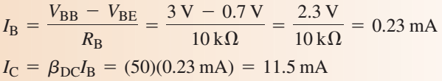
Solution 2
Assume that the circuit is working linearly

Slide 30
Solution 2
I_{C} = (V_{CC} – V_{CE}) / R_{C}
Saturation Mode

Slide 31
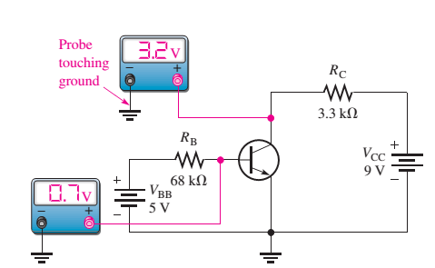
Exercise 3
Determine β_{DC}

Slide 32
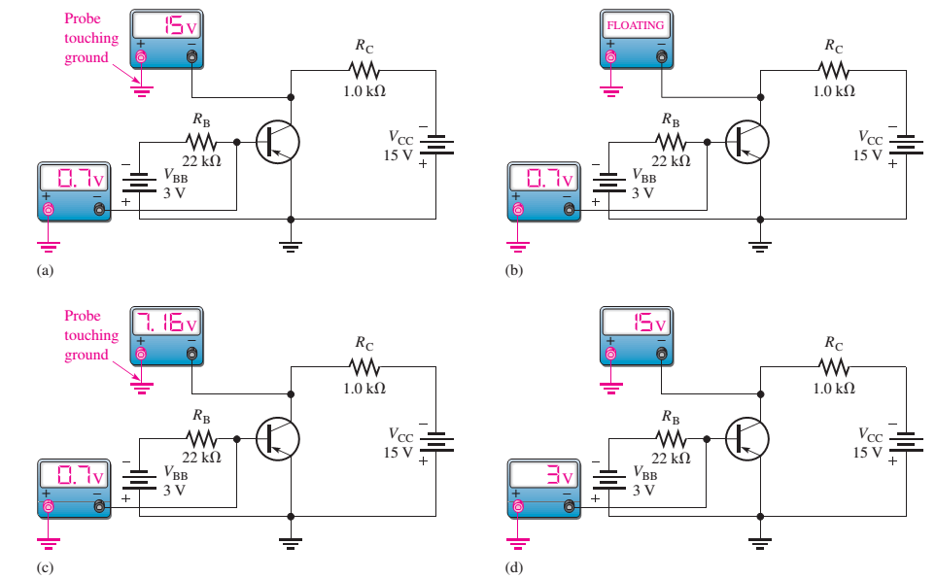
Exercise 4

Slide 33
Exercise 4
Explain why VC is 15V

Slide 35
Exercise 4

Slide 36
Exercise 4

Slide 37
Exercise 4

Slide 38
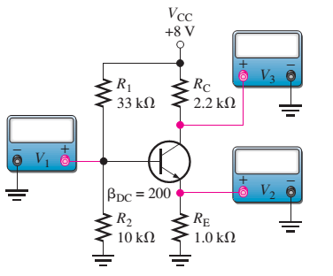
Exercise 5

Slide 39
Midterm (45 mins – Closed Book)
Multichoice + Written
Chapter 1: Basic Electronic Components
Deterimine the resistor values (4-band colors, 5-band colors)
LEDs connectors (Serial + Parallel)
Chapter 2: Diode
Diode Principles and Models
Applications using Diodes
Chapter 3: BJT (npn)
Amplifier Coefficient, Applications
Vbe = 0.7 (for default)

